Slide 1
Optimizing Volunteer Placement
NWA Global Solutions

Slide 2
Overall Goal
Maximize gala attendance by placing volunteers in optimal locations for capturing the target audience

Slide 3
Subgoals
Clean Data
Differentiate stops (popularity, commuter, etc.)
Station selection
Visualization

Slide 4
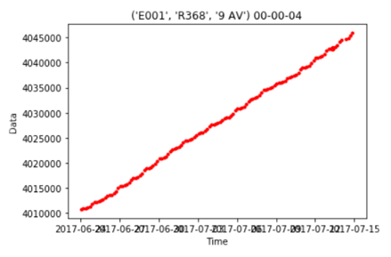
Data Cleaning Process
If the data are correct, the relationship between the data at a turnstile should be increasing like this,
Turnstile Count

Slide 5
Type of Errors
More than 100 turnstiles have incorrect data, in 3 types
1
Monotonic Decreasing
2
Garbage Values
3
Turnstile Resets

Slide 6
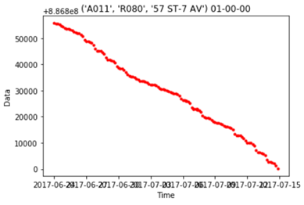
Monotonic Decreasing

Slide 7
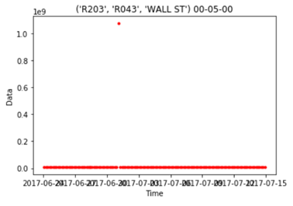
Garbage Value
Garbage!

Slide 8
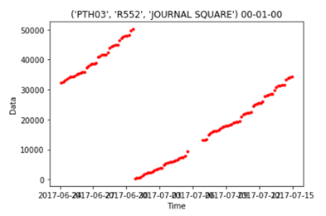
Turnstile Reset
It resets!

Slide 9


Commuter Index & Commuter Multiplier

Slide 10
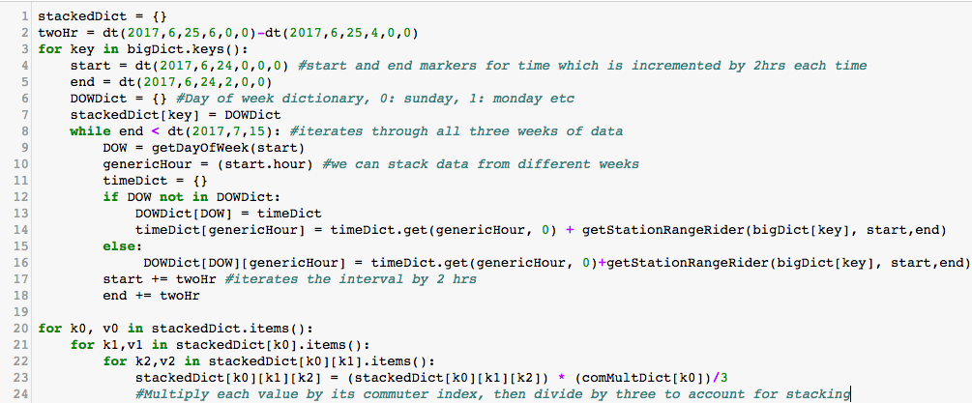
Week Stacking

Slide 11
Station Selection Algorithm
It is a simple “Greedy” algorithm, “choose the best place first!”
Two Golden Rules
Choose one with high commuters
Don’t go to the same place!

Slide 12
Example of Location Assignment
Now, each volunteer will have their assigned locations in a text file.
Example
Station Assignment for Andrew (Long) Ngo (Id: 0)
Sunday 10:00 - 12:00 at ('D002', 'R390', '8 AV')
Sunday 14:00 - 16:00 at ('R161B', 'R452', '72 ST')
Monday 08:00 - 10:00 at ('PTH17', 'R541', 'THIRTY THIRD ST')
Monday 16:00 - 18:00 at ('R533', 'R055', 'FLUSHING-MAIN')
...

Slide 13
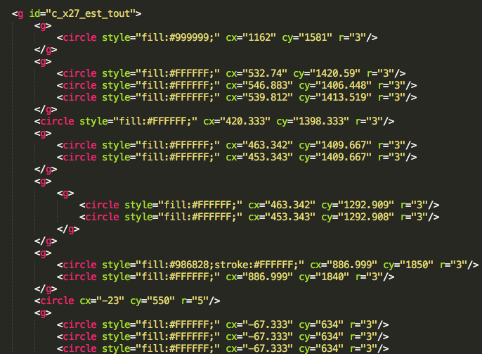
Visualization method
Extract data
Clean points
Label points
Translate points

Slide 15
